Slide 1
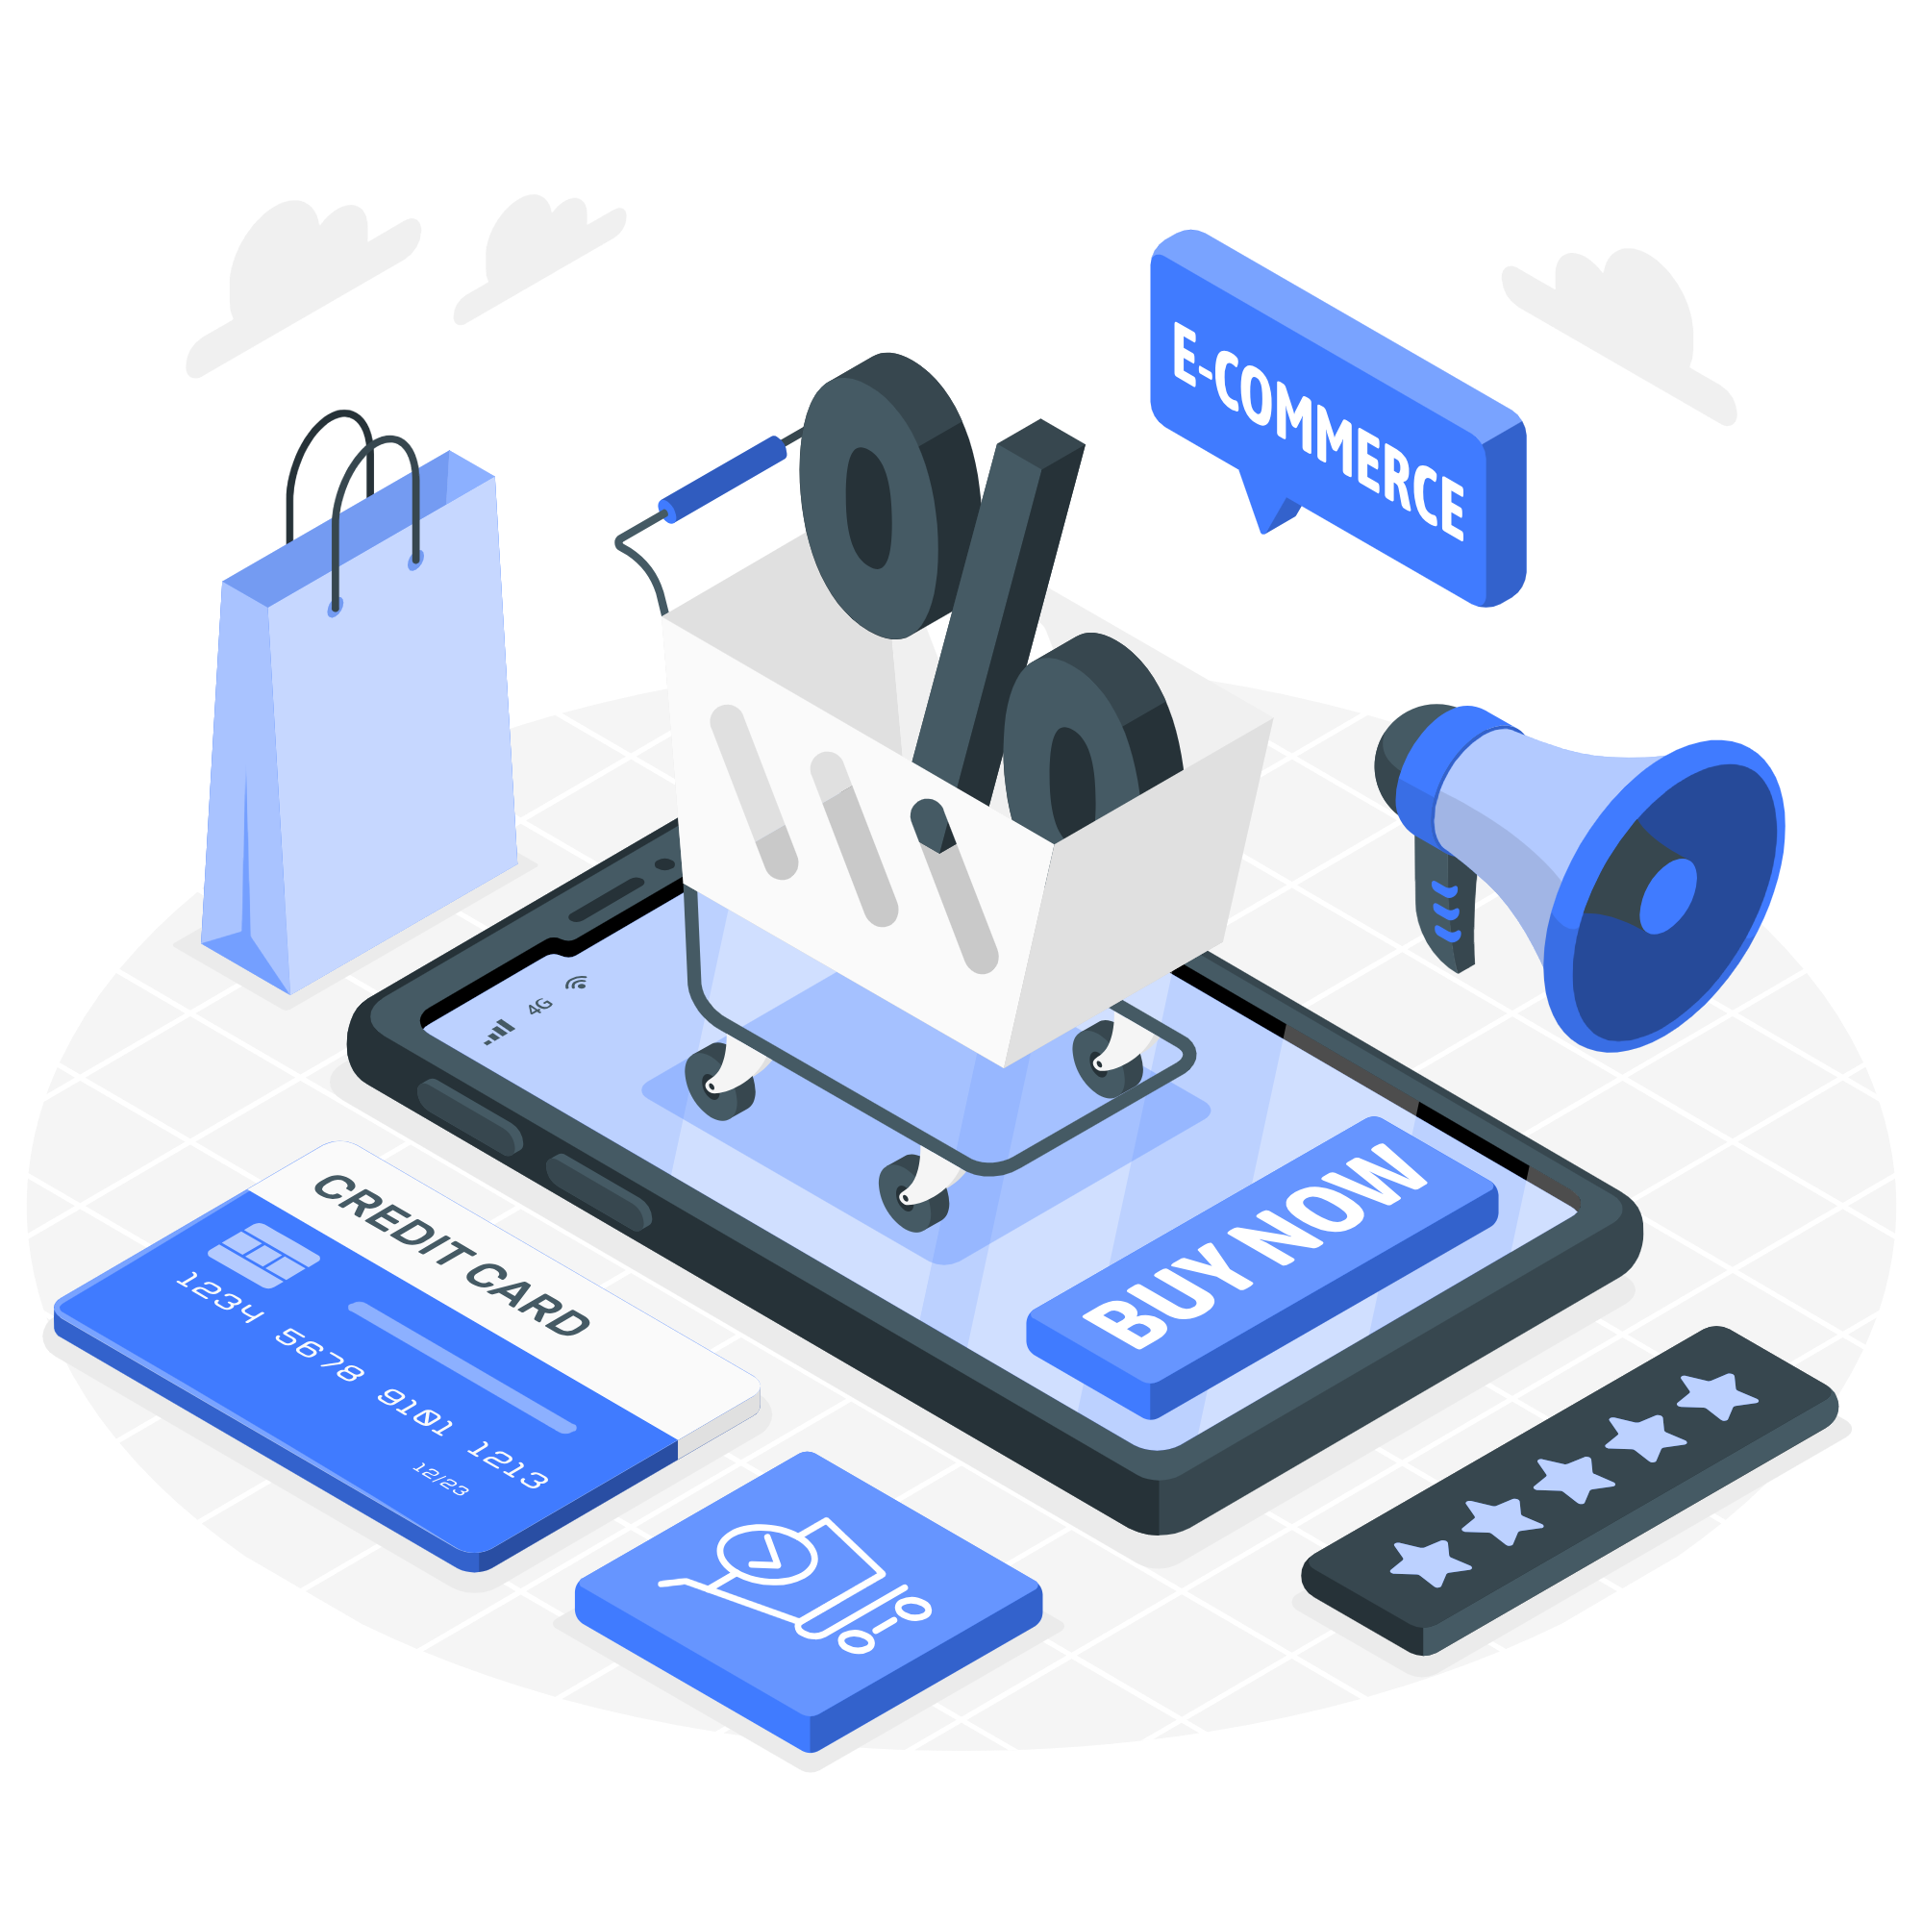
Olist E-commerce Business Analysis Project
Name: Le Nguyen Ngoc Yen
Class: BI-33

Slide 2
Table of contents
01
02
03
04
05
06
Introduction
Data understanding
Data pre-processing
Data analyzing
Visualization
Insights &
Recommendations

Slide 3
01
Introduction

Slide 4

What is Olist?
E-commerce site for sellers
Connect merchants and products to the marketplace of Brazil and some other countries → connecting sellers and buyers
Similar to Shopee
Different from Amazon.com → does not hold inventories or sell its own products
Pagan Research 2017

Slide 5
About the dataset
Brazilian E-commerce Public Dataset by Olist - Kaggle
Real commercial data with anonymization
Data was collected from Sept 2016 to Oct 2018
Olist 2021

Slide 6



Tools used
Python
SQL Server
Power BI

Slide 7
02
Data understanding

Slide 8
Data understanding
9 tables with the information of 100k orders from customers → drop tables about geolocation and sellers
understand data dictionary provided in the dataset → new concepts: freight value, the difference between shipping and delivery, boleto payment in Brazil
understand the data schema

Slide 9

Data schema

Slide 10
03
Data pre-processing

Slide 11
Data pre-processing
Checking
Number of rows and columns
Null values
Duplicate values
Number of unique values in each column
Overall structure of the dataset
Adjusting
Drop unnecessary columns
Change data types in some datetime columns
Replace Portuguese by English product names
Changing the dataset

Slide 12

04
05
Data analyzing & Visualization
&

Slide 13



Overview
Business overview
Customer analysis
Product analysis

Slide 14
Concept definition
Pareto principle
Product bundling
01
02

Slide 15
Pareto principle
20% of causes responsible for 80% of outcomes
→ 20% of factors (products, customers,...) contribute to most of the business performance.
⇒ prioritizing, not ignoring
Tardi 2022

Slide 16
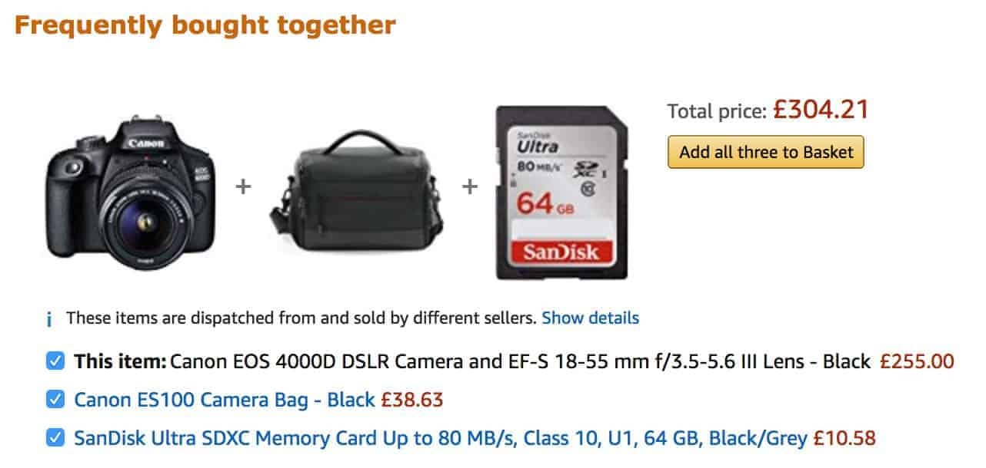
Product bundling
An offspring of up-selling and cross-selling
Bundle a main product with an auxiliary product for a higher price Example:
Suresh 2015

Slide 17
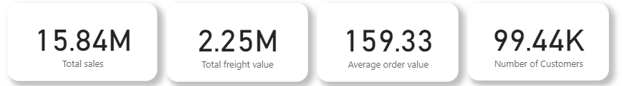
Business overview

Slide 18
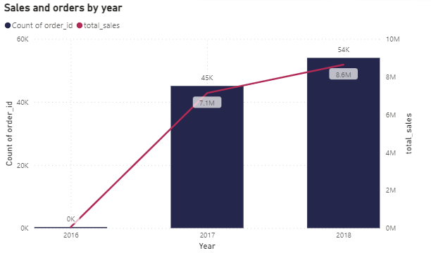
Business overview
2016 witnessed the lowest orders and sales since the data was only collected from September.
Both number of orders and sales rose by 20% from 2017 to 2018.

Slide 19
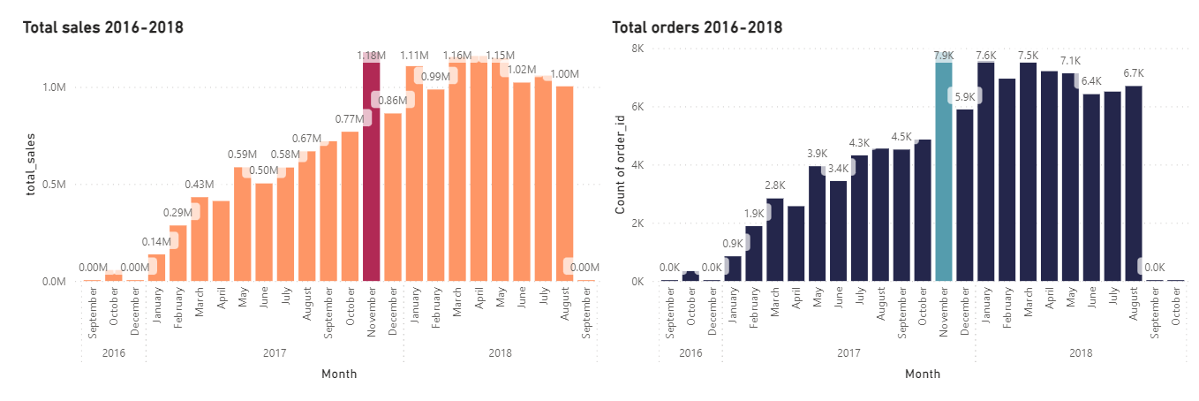
Business overview

Slide 20
Business overview
Abnormally high orders and sales in Nov 2017 → the most successful and biggest Black Friday thanks to early promotional programs and the boom of online shoppers.
CBS 2017; Xavier 2018

Slide 21
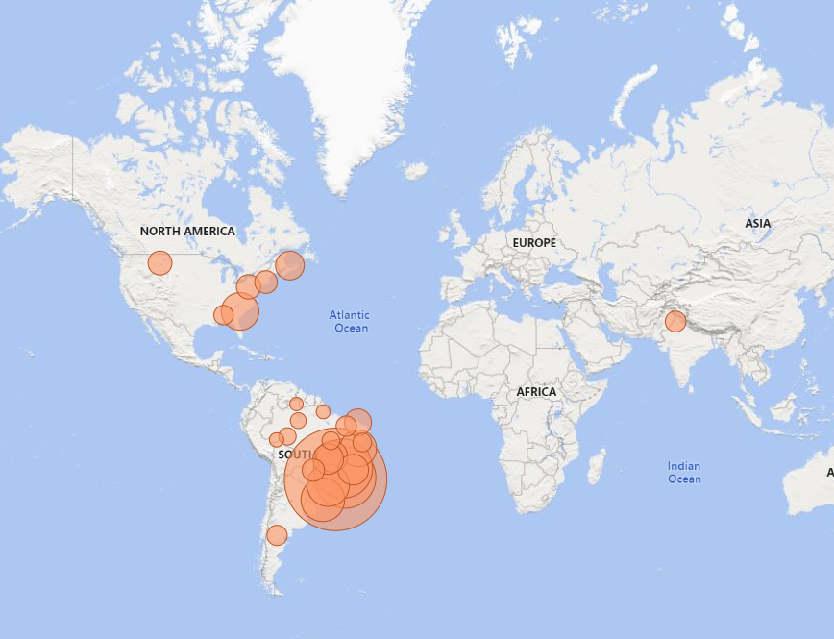
Business overview
Most Olist customers came from South America region, specifically Brazil.
Top 3 cities with the most customers: Sao Paulo, Rio de Jainero and Minas Gerais.

Slide 22
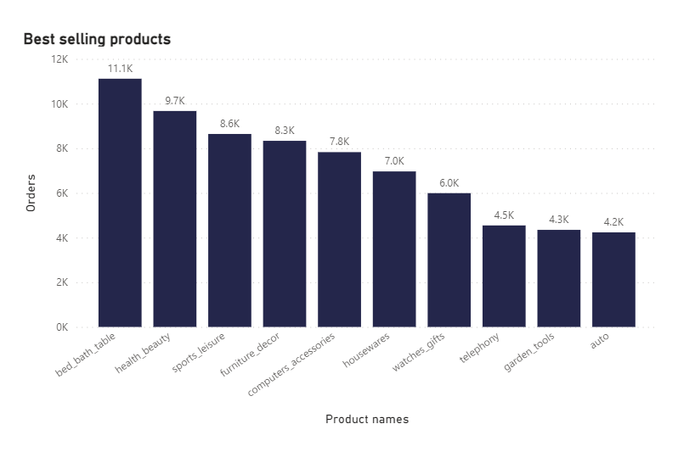
Business overview
Top 3 best selling product categories were bed_bath_table, health_beauty and sports_leisure.

Slide 23
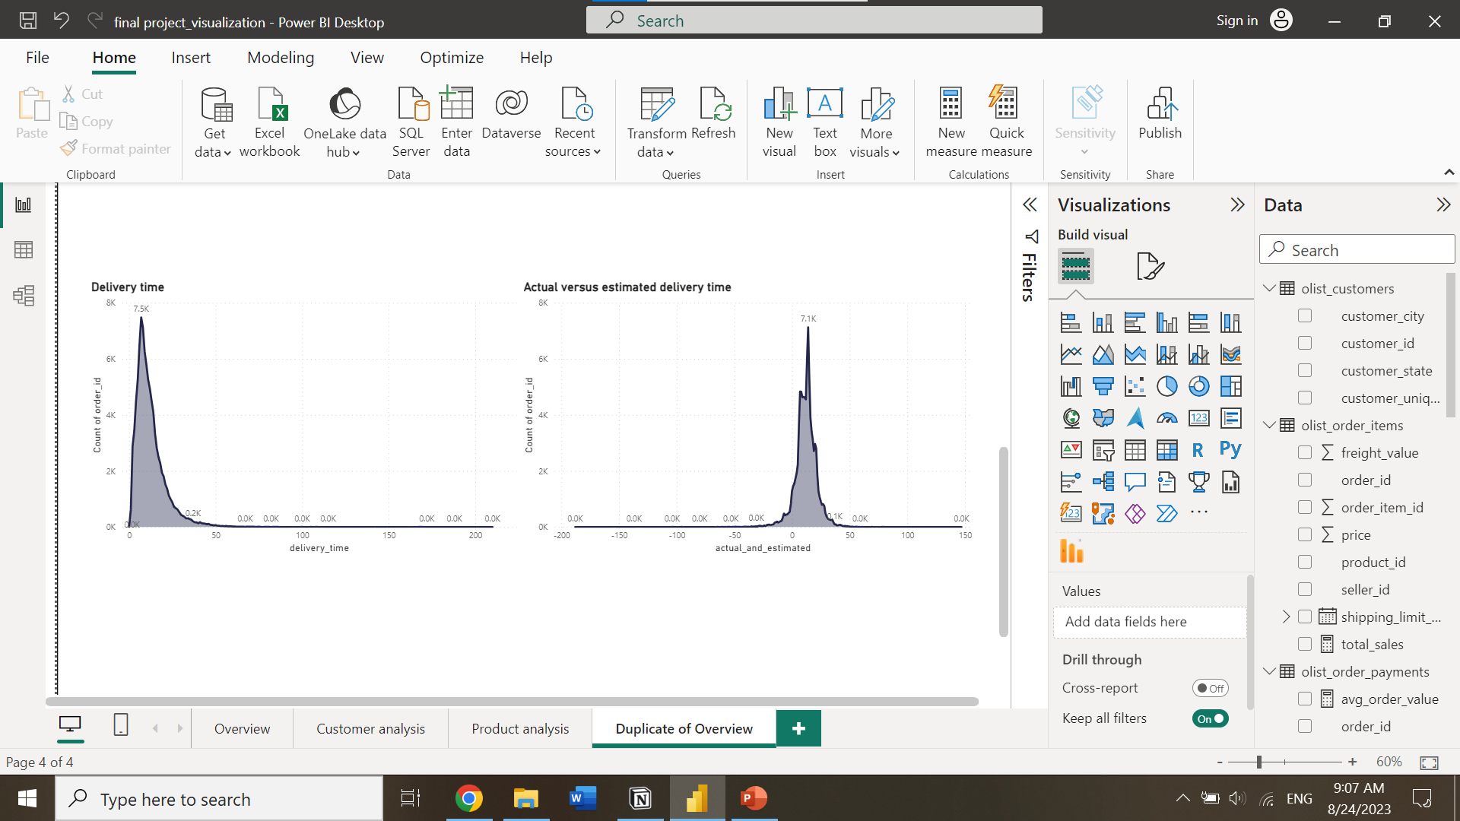
Business overview
Most orders were delivered within 7 days from the approval time.
Generally, orders took 4-14 days to be delivered.

Slide 24
Business overview
Most orders were delivered 14 days before the estimated delivery time.
Generally, quite a number of orders were late up to 2 weeks.

Slide 25
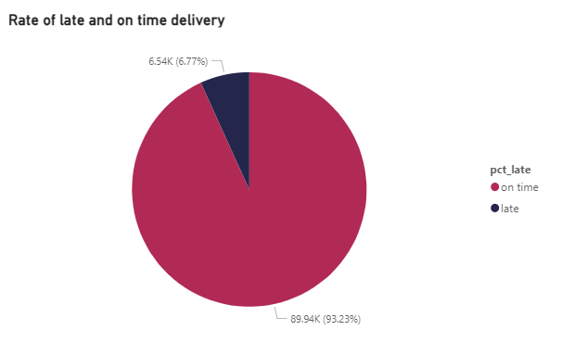
Business overview
On-time delivery was 93.23% while late ones took up 6.77%

Slide 26
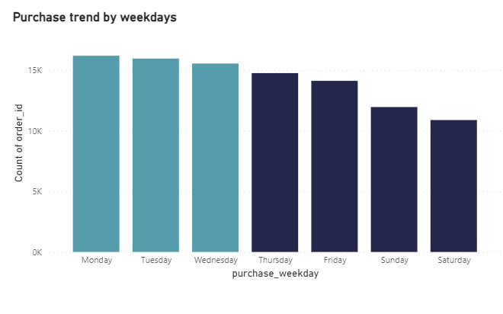
Customer analysis
Customers ordered products mostly from Monday to Wednesday.
Saturday and Sunday saw the lowest orders.

Slide 27
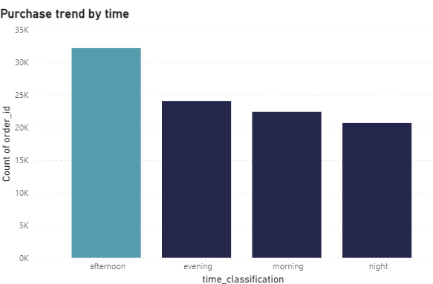
Customer analysis
Customers generally ordered on Olist from 12pm to 5pm.

Slide 28
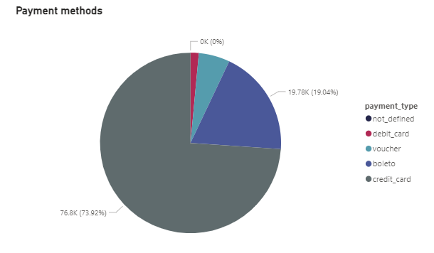
Customer analysis
A large proportion of customers paid by credit cards and boleto.

Slide 29
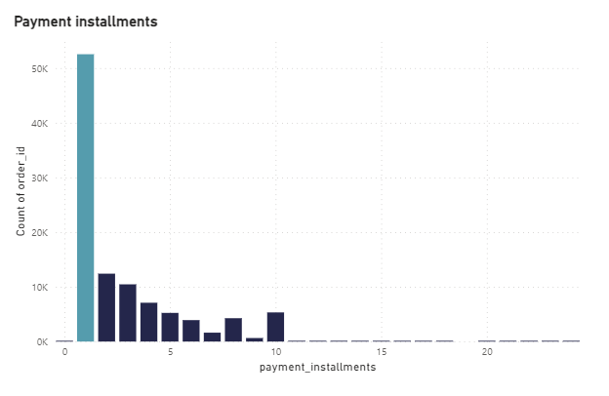
Customer analysis
Customers choosing installment plan usually paid off within one month.

Slide 30
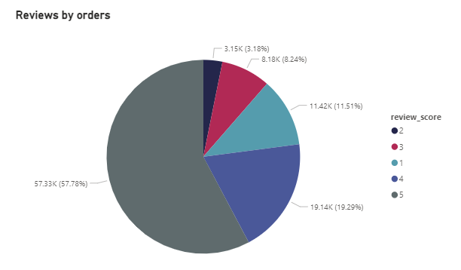
Customer analysis
Most customers were satisfied with their orders (4-5).
However, 1-star rating took up the third place in the chart.

Slide 31
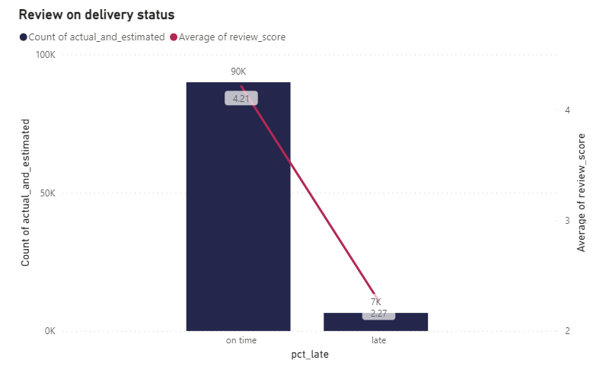
Customer analysis
On-time deliveries received an average rating of 4.2; late ones, 2.3

Slide 32
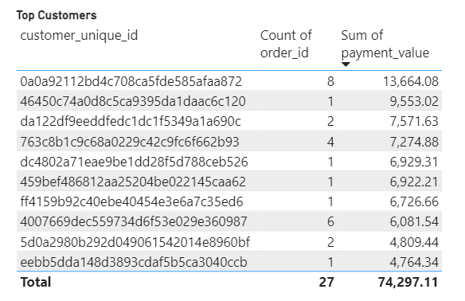
Customer analysis

Slide 33
Product analysis
Pareto analysis shows that 18/72 products (25%) contributed to about 80% of the total prices (excluding freight value) of Olist store.
Top 3 product categories were health_beauty, watches_gifts and bed_bath_table.
Product category | Percentage
A | 25% (80%)
B | 22% (15%)
C | 53% (5%)

Slide 34
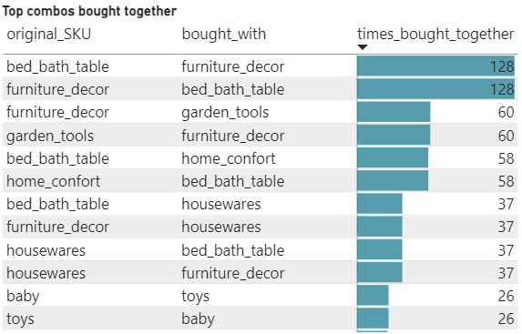
Product analysis
Top 3 product categories frequently bought together were:
bed_bad_table & furniture_decor (128 orders)
furniture_decor & garden_tools (60 orders)
bed_bath_table and home_comfort (58 orders)

Slide 35
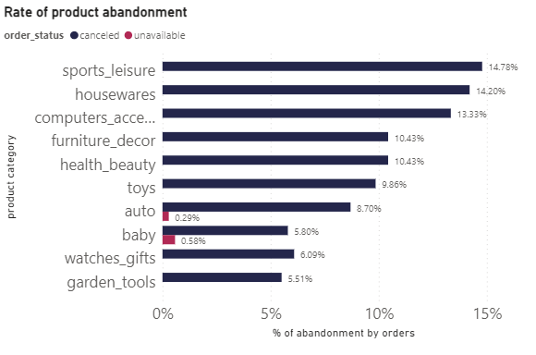
Product analysis
Top 3 product categories with high rates of cancellation were sports_leisure, housewares and computers_accessories (13-15%)

Slide 36
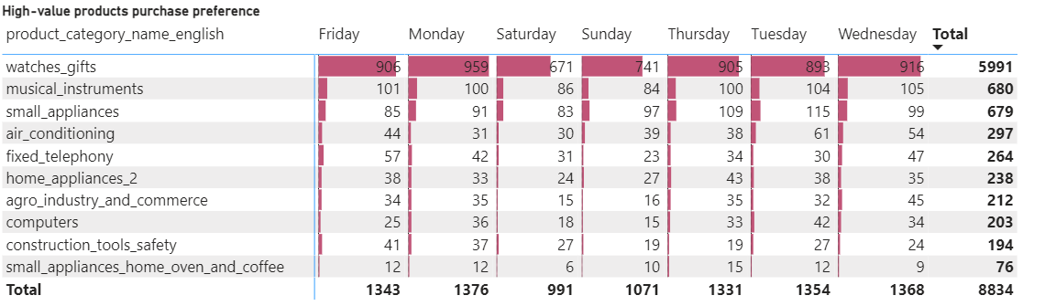
Product analysis
High-value product categories were generally purchased on Monday, Wednesday and Friday.

Slide 37
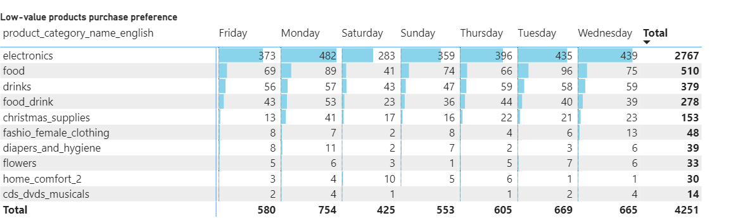
Product analysis
Low-value products were purchased mostly from Monday to Wednesday.

Slide 38
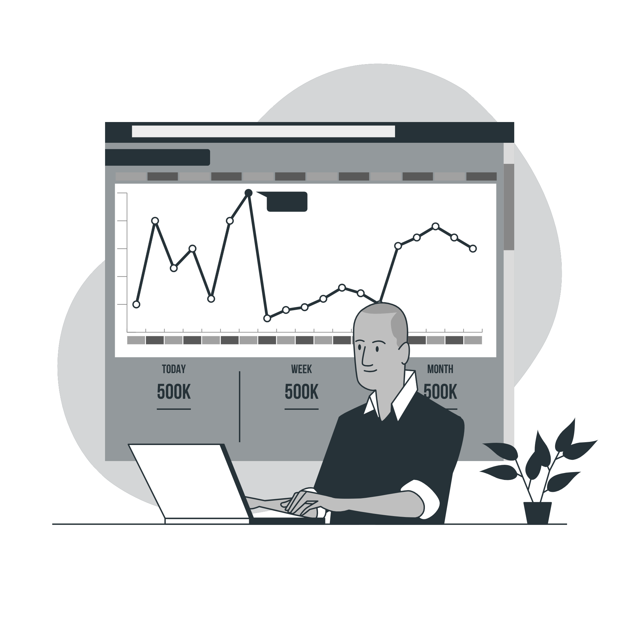
06
Insights & Recommendations

Slide 39
About customers
Insights
Recommendations
The most preferred payment was credit card
Debit card and voucher were not used as much in Olist store
Consider partnering up with banks of most users to improve services
Diversifying payment methods by offering discounts
Digital wallets are becoming more popular → promoting this payment method to attract more customers

Slide 40
About customers
Insights
Recommendations
Although most customers were satisfied with Olist service (based on score 4-5), 1-star review was still pretty high
Improving customer service → respond to customers’ request and solve problems quickly
Offer great user experience (user-friendly website, smooth check-out and appealing products)
Reducing the rate of late delivery by checking the quality of existing shipping partners

Slide 41
About customers
Insights
Recommendations
Top customers in Olist didn’t really contribute much to the total sales since their purchase frequency was pretty low.
Create loyalty program for customer with repeated and high-value transactions
Boost marketing through emails, newsletters and social media to encourage customers to return

Slide 42
About products
Insights
Recommendations
Through Pareto and ABC analysis, the best and worst selling products of Olist store could be identified.
Prioritize products in category A and enhance their quality to sell more
Category B products can be promoted to A tier by marketing and improving product quality
Some products in category C should be stopped manufacturing due to the extremely low sales

Slide 43
About products
Insights
Recommendations
By analyzing products that were frequently bought together, suitable strategies can be applied to boost revenues
Product bundling recommendation system can be applied to make customers purchase more (1 coffee table + 1 sofa for 5% off)
Suggest a popular item with a less popular yet reasonable item to increase sales and reduce inventories at the same time

Slide 44
About products
Insights
Recommendations
Top 3 most abandoned product categories were in top 5 of highest sales.
There could be several reasons:
Slow delivery
Lack of preferred payment method
Problems during check-out process
Prices of the products
→ Find out the biggest issue and fix it to not affect the store sales

Slide 45
About products
Insights
Recommendations
Purchase time analysis was done on two groups of products: high versus low-value and the most popular purchase days were found accordingly
Sellers from Olist can choose suitable time and days to launch new products, promote products and offer sales:
High-value products: On Monday, Wednesday and Friday afternoons
Low-value products: On Monday, Tuesday and Wednesday afternoons

Slide 46
About products
Insights
Recommendations
Generally, November witnessed great sales thanks to a series of special days (Thanksgiving, Black Friday and Cyber Monday)
Nowadays, people start shopping earlier before November to avoid the chaotic sales near holiday season → stock up inventories to avoid shortage
Black Friday is considered a day of overconsumption → offer recycled packaging and send emails about eco-friendly tips
Collier 2022

Slide 47
Resources
CBS (2017). Retailers share Black Friday 2017 ads earlier to entice customers - CBS News. [online] www.cbsnews.com. Available at: https://www.cbsnews.com/news/black-friday-2017-retailers-early-sales-ads/ [Accessed 25 Aug. 2023].
Collier, J. (2022). Eye-Opening Black Friday Statistics and Trends for 2022. [online] www.activecampaign.com. Available at: https://www.activecampaign.com/blog/black-friday-statistics [Accessed 25 Aug. 2023].

Slide 48
Resources
Olist (2021). Brazilian E-Commerce Public Dataset by Olist. [online] www.kaggle.com. Available at: https://www.kaggle.com/datasets/olistbr/brazilian-ecommerce [Accessed 25 Aug. 2023].
Pagan Research (2017). Olist. [online] paganresearch.io. Available at: https://paganresearch.io/company/olist [Accessed 25 Aug. 2023].

Slide 49
Resources
Suresh, S. (2015). How to Upsell & Cross-sell? Strategies To Boost revenue. [online] VWO. Available at: https://vwo.com/blog/use-upsell-cross-sell/.
Tardi, C. (2022). How to Apply the 80-20 Rule. [online] Investopedia. Available at: https://www.investopedia.com/terms/1/80-20-rule.asp.
Xavier, M. (2018). Brazil’s Most Important Ecommerce Shopping Dates and How to Prepare. [online] LABS English. Available at: https://labsnews.com/en/articles/ecommerce/brazil-ecommerce-shopping-date/ [Accessed 25 Aug. 2023].

